Slide 1




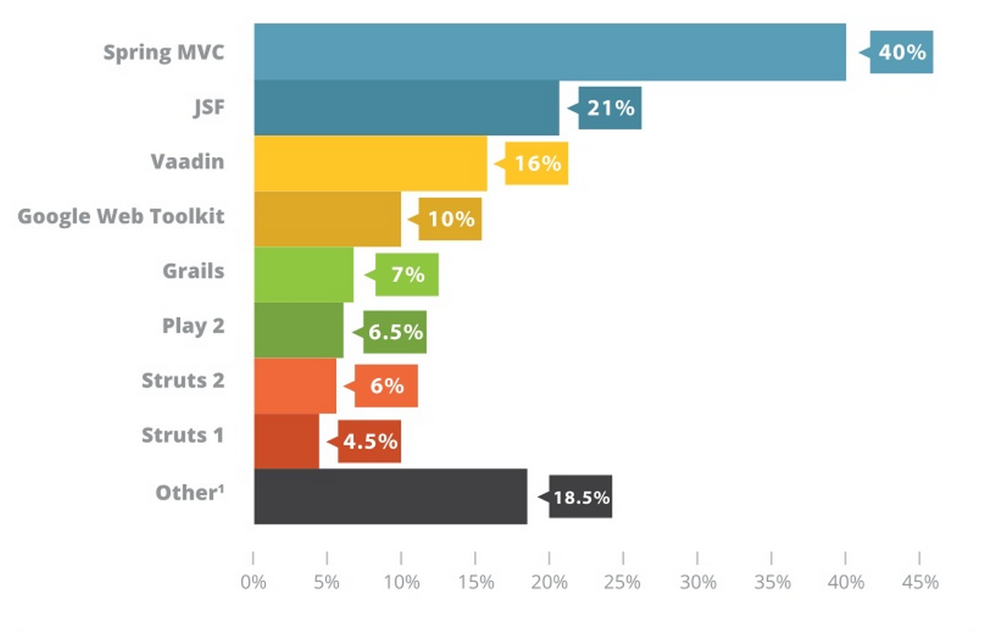
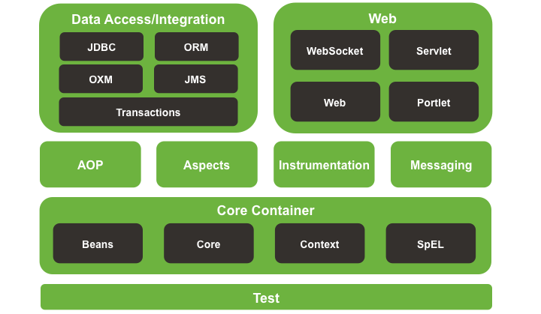
Research Application Development Frameworks for Java Enterprise Development and Develop JEE Prototype with Framework
David Kelly
Institute of Technology Blanchardstown: Year 4 Thesis Project
ABSTRACT
The aim of this project is to research four popular Java Enterprise Edition compatible frameworks and develop a JEE prototype application from one of the researched frameworks. The Java EE platform provides an API and runtime environment for developing and running large-scale, multi-tiered, scalable, reliable, and secure network applications. With many multifaceted components making up a JEE application it is easy for a developer to be obstructed from creating the application they wish and can find themselves bogged down in the technical processes of simply getting the application to function.
A framework’s primary purpose is to aid and ease an applications development process. It should allow for an application to develop quickly and easily and should result in a superior finished application. Upon researching these frameworks, I will evaluate their core features and analysing how each framework is suited to be implemented within a JEE application.
I will develop a JEE prototype application using one of the frameworks I feel can further my understanding. While developing the application I will document and compare how the framework provides an advantage over the standard Java API, further I will asses the learning curve involved with implementing the chosen framework.
PROJECT TO DATE
Currently the four frameworks to be researched have been selected, Spring, Hibernate, Google Web Toolkit, Vaadin. In order to research these JEE compatible frameworks I have earmarked tutorial guides to create basic applications that display the features of each specific framework.
Tutorials
Building REST services with Spring [1]
Web application that displays data from database with Hibernate [2]
Client-Server communication with GWT [3]
Address book with Vaadin [4]
1. Web frameworks in use survey results
In researching frameworks I discovered that Spring is the most widely used among Java developers. Software development community zeroturnaround commissioned a survey to find out what Java frameworks are most used by current developers. 2164 developers responded with 40% currently using Spring [5]. While conducting my literature review connected to this project I came across a paper where the authors argue the case that Spring architecture provides a more intuitive developer experience citing claims form one of the authors that, he tried to develop an EJB application in the past and found the experience confusing and obtuse. Later the author developed an application implementing Spring and found he was able to produce more complex code faster and more easily [6].
FUTURE WORK
I must develop the four tutorial applications and document all aspects of the life cycle. In order to compare frameworks, standards must be set for measured results. After developing the tutorial applications The development of the Spring prototype application can begin. As of yet I do know know what the exact application shall be but it is important to choose an application that both demonstrates Spring and is also manageable relative to time and technical difficulty.
REFERENCES
1. https://spring.io/guides/tutorials/bookmarks/
2. https://netbeans.org/kb/docs/web/hibernate-webapp.html
3. http://www.gwtproject.org/doc/latest/tutorial/index.html
4. https://vaadin.com/tutorial
5. ZeroTurnAround. 2014. Top 4 Java web frameworks revealed. [ONLINE] Available at: http://zeroturnaround.com/rebellabs/top-4-java-web-frame works-revealed-real-life-usage-data-of-spring-mvc-vaadin-gwt-and-jsf/. [Accessed 22 October 15]
6. John Arthur and Shiva Azadegan. Spring framework for rapid open source j2ee web application development: a case study. pages 90–95, May 2005.
B00060572@student.itb.ie

